Slide 1
Utah Council of Land Surveyors
February 28, 2013

Slide 2
"The longer I live, the more I realize the impact of attitude on life… The remarkable thing is we have a choice every day regarding the attitude we will embrace for that day. We cannot change the inevitable. The only thing we can do is play on the one string we have, and that is our attitude ... I am convinced that life is 10% what happens to me, and 90% how I react to it. And so it is with you ... we are in charge of our attitudes."
-Charles Swindoll

Slide 3
Utah Council of Land Surveyors
February 28, 2013

Slide 4
CoNTRACT ISSUES FOR DESIGN PROFESSIONALS
Adam T. Mow, Esq., AIA
Jeffrey M. Hirst, CIC

Slide 5
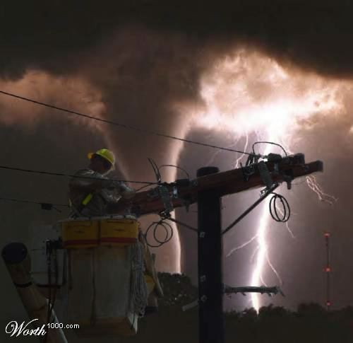
Life Is Full of Risk

Slide 6

When the Unexpected Happens

Slide 7

Things Don’t Work Out as Planned

Slide 8

You May Fall Into a Tough Spot

Slide 9
CoNTRACT ISSUES FOR DESIGN PROFESSIONALS
Adam T. Mow, Esq., AIA
Jeffrey M. Hirst, CIC

Slide 10
Introduction
Economic downturn dilemma:
  Need work
  Sometimes “forced” to accept a bad contract to get the work.
Long-term and short-term implications with financial consequences
Recovery mode – have the bargaining powers shifted?

Slide 11
Introduction
Long-term implications:
  Onerous provision or obligations
  Project difficulties
  Exposure to claims
    Deductible and premium exposure
    Stress and inefficiency (lost billable hours)
    Uncovered claims
  Payment risk
  Reputation
  Opportunity cost

Slide 12
Introduction
Short-term implications:
  Revenue
  Staying busy
  Early project challenges
    Programming
    Design
    Bidding

Slide 13
Comparison
Long-term implications:
  Onerous provision or obligations
  Project difficulties
  Exposure to claims
    Deductible and premium exposure
    Stress and inefficiency (lost billable hours)
    Uncovered claims
  Payment risk
  Reputation
  Opportunity cost
Short-term implications:
  Revenue
  Staying busy
  Early project challenges
    Programming
    Design
    Bidding

Slide 14
Today’s Objectives
Overview of contract formation and negligence principles
Discuss common contracting practices – between engineering firms and their clients.
Reference specific contract clauses - that present legal and insurance problems
Establish foundation principals - for proper contracting practices
Offer solutions - for addressing the problems

Slide 15
Overview
Contract Formation and Negligence Principles

Slide 16
Contract Formation
Requisite Components:
  An offer
  Acceptance to the offer
  Exchange of consideration (i.e. value)

Slide 17
Contract Formation
Other aspects:
  Contracts can be formed orally or in writing, through one or multiple documents
  Acceptance does not require a signature
    May accept an offer through words or actions

Slide 18
Negligence
Professional Liability (aka malpractice) is generally based on negligence.
A finding of negligence requires:
  A duty owed
  Breach of that duty
  Damages caused by the breach

Slide 19
Negligence
The duty of a professional in performing services is also known as the standard of care
A professional may make an error in judgment or a mistake or may disagree with other professionals without failing to follow the standard of care.
  More to come on the standard of care…

Slide 20
Common Contract Problems

Slide 21
Riddling Common Contract Problems
Billing and Payment
Scope of Service
Standard of Care
Warranty, Guarantee, and Certification
Indemnification
Insurance Requirements
Time and Delays
Inspection and Supervision

Slide 22
Billing and Payment

Slide 23
Billing and Payment
General rule: If you sue for fees, you will be counter sued for professional negligence
Secondary rule: If the project is over budget, the cost of change orders will be deducted from your final fee
Tertiary rule: If other team members aren’t paid, then you may not get paid

Slide 24
Billing and Payment
Consider the following:
What do you do about this?
…Engineer acknowledges that Engineer is relying on the financial ability of Owner and not Architect for payment. As a condition precedent to Engineer receiving any payment under this Agreement, Architect must have first received from the Owner the corresponding payment

Slide 25
Billing and Payment
What about liens?
From Utah Code section 38-1-3 regarding who is entitled to a mechanic’s lien:
  “[E]ngineers . . . who have furnished designs, plats, plans, maps, specifications, drawings, estimates of cost, surveys or superintendence, or who have rendered other like professional service . . .shall have a lien upon the property upon or concerning which they have rendered service . . . .”

Slide 26
Scope of Services

Slide 27


Scope of Service
“Assumptions are the termites of relationships”
  Henry Winkler
  Who is Henry Winkler?

Slide 28
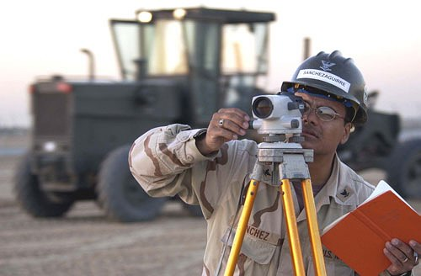
Scope of Service
How do you define “scope” anyway?
  “area covered by a given activity”
  “aim or purpose”
  “extent or range of operation”

Slide 29
Scope of Services
What should the scope entail?
Consider the following:
What are the problems with this scope?
…The work described herein… Civil engineering including survey utility plan, construction staking, grading/drainage plan, SWPP and all required meetings and all related work

Slide 30
Scope of Services
Consider the following claim example:
Failure on an excavated wall that is part of water tank construction. The wall is approximately 70 feet high in soil and bedrock. Firm informed contractor and prime engineer to not exceed the recommended slope angle. The prime engineer did not allow for site observation because it was not part of the budget and contract for materials testing. In the absence of the site obervations, the contractor exceeded the recommended slope angle.

Slide 31
Standard of Care

Slide 32
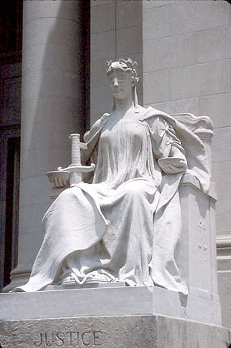
Standard of Care
“We do what we must, and call it by the best names.”
  Ralph Waldo Emerson

Slide 33
Standard of Care
What is the standard by which you are measured?
To paraphrase:
  That degree of care and skill exercised by a professional practicing in the same geographic area under similar circumstances.

Slide 34
Standard of Care
Consider the following:
Implications….
Subcontractor shall perform its work in a workmanlike and skillful manner and in strict accordance with the contract documents

Slide 35
Standard of Care
Utah Model Jury Instruction for Design Professionals
  Design professional is not held to a standard of perfection
  Design professional can make a mistake and not be negligent

Slide 36
Warranty and Guarantee

Slide 37
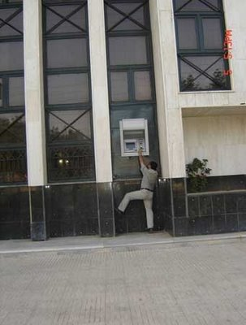
Warranty and Guarantee
“If you want a guarantee, buy a toaster.”
  Clint Eastwood

Slide 38

Warranty and Guarantee
Consider the following:
Remember the standard!
You warrant your work against all defects and deficiencies in your workmanship. You agree to provide special warranties as required in the contract documents. Your responsibility for patent or latent defects extends beyond the warranty period to the maximum time allowed by law.

Slide 39
Warranty and Guarantee
“Aren’t you going to stand behind your work?”
Engineer’s and Surveyor’s Paradox
  Is it okay to certify, warranty, or guarantee?
    Insurance answer = ______________
  What do those words really mean?

Slide 40
Indemnification

Slide 41
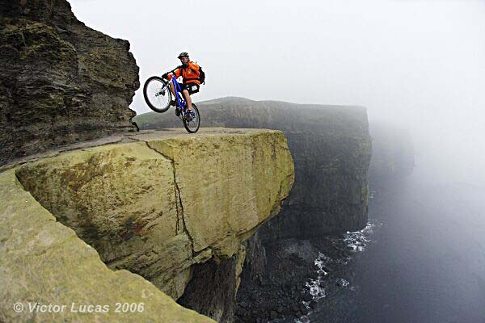
Indemnification
“Ah, this is obviously some strange usage of the word ‘safe’ that I wasn’t previously aware of.”
  Douglas Adams
    Author: Hitchhiker’s Guide to the Galaxy

Slide 42
Indemnification
Professional Liability policies have an exclusion called the “Contractual Liability Exclusion”
  The policy excludes coverage for any liability assumed in a contract or agreement…
  …except for liability that would exist in the absence of the contract or agreement
What liability exists in the absence of the contract or agreement?

Slide 43
Indemnification
How far can you go with indemnification?
Consider the following:
Subcontractor shall indemnify, defend, and hold harmless Contractor, Owner, Architect, and Contractor’s subcontractors, officers, agents, employees, affiliates, and invitees from any and all claims, damages, costs, attorney fees, expenses, losses, or liabilities of every kind and nature whatsoever in any way related to Subcontractor’s work

Slide 44
Indemnification
Remember the contractual liability exclusion
Consider the following:
Subcontractor shall indemnify, defend, and hold harmless Contractor, Owner, Architect, and Contractor’s subcontractors, officers, agents, employees, affiliates, and invitees from any and all claims, damages, costs, attorney fees, expenses, losses, or liabilities of every kind and nature whatsoever in any way related to Subcontractor’s work

Slide 45
Senate Bill 124
Special recognition: Clint Topham and Michael Smith for leading the ACEC charge on this measure
  Effective May 12, 2009
  Affects state contracts
  A design professional not required to provide indemnification to another party unless results from design professional’s negligent act, error, or omission

Slide 46
Insurance

Slide 47

Insurance
Top four reasons to worry about insurance:
  Paying premium is fun
  Insurance policies are a great read
  If you don’t have it when (or how) you need it most, then you’ll miss it dearly
  Clients want it

Slide 48
Insurance Requirements
Contracts often ask you to carry “blanket” contractual liability coverage
Insurance required to “cover obligations” in indemnification clause
Be careful about excessive insurance limits or requirements

Slide 49
Insurance Requirements
Consider the following two clauses:
Maintain insurance amounts equal to the minimum limits set forth in the Prime Contract
The obligations contained in this agreement shall not be limited in any way by any insurance or coverage requirements contained herein

Slide 50
Time and Delays

Slide 51
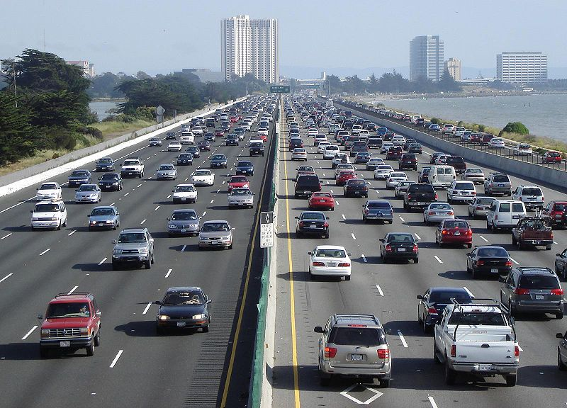
Time and Delays
“I love deadlines. I like the whooshing sound they make as they fly by”
  Douglas Adams
    Author: Hitchhiker’s Guide to the Galaxy

Slide 52
Time and Delays
Consider the following:
Time is of the essence of this Agreement. Engineer will be responsible for all damage caused by its delay, including liquidated damages Owner assesses against Architect.

Slide 53
Time and Delays
Furthermore, consider the following:
We retain the right to modify, suspend, delay or accelerate the schedule(s) for timely project completion. You agree to adapt your efforts to meet the schedule(s) as changed without additional cost

Slide 54
Inspection and Supervision

Slide 55

Inspection and Supervision
Inspect:
  “to view or examine formally or officially “
  “examine carefully for accuracy with the intent of verification”
Supervise:
  “to oversee during execution or performance; superintend; have the oversight and direction of.”

Slide 56
Inspection / Supervision
To inspect or not to inspect…
Consider the following:
Engineer shall supervise and inspect the work of its employees and other related work during the performance of its work

Slide 57
Inspection / Supervision
Consider the following claim example:
Design firm was hired to be on-site 2-4 hours a day during construction
Plaintiff was riding a motorcycle on trust lands, climbed a hill that was excavated on the other side and fell 50 feet. The excavation was part of a road construction project. Filed suit against contractor and design team alleging design negligence.

Slide 58
Other Contractual Interests
Role and Relationship
Flow Down from Prime
Job Site Safety
Site Conditions
Tips on Negotiating

Slide 59
Wrap-Up
Review and understand your obligations
Don’t just sign and assume that all will be fine
Educate your client – they may have different expectations
When in doubt, consult with legal and insurance counsel

Slide 60
Questions?
Adam T. Mow, Esq., AIA
adam@babcockscott.com
801-531-7000
Jeffrey M. Hirst, CIC
jhirst@american-ins.com
801-364-3434
THANK YOU!

